Slide 1
NYC Shootings Time Series Analysis
by John Mazon
DATA 698 Thesis Paper Presentation
5/16/22

Slide 2
NYC Crime activity trend analysis
New York City’s historic crime fluctuation over the past quarter of a century has been identified as an investigative phenomena. New York City’s dramatic crime decline is a real brain teaser according to crime analytics experts. No one predicted it and, as of yet, no one has explained it, at least to the satisfaction of most social scientists who study crime trends.
One key factor all historic Data Analyst remember to do is taking seasonality into consideration for time series analysis. According to O’neil(2009, pp.101) Seasonality, as its
name suggested, refers to the seasonal characteristics of the time series data. It is the predictable pattern that repeats at a certain frequency within one year, such as weekly,
monthly, quarterly, etc. The most straightforward example to demonstrate seasonality is to look at the crime data. We always expect the crime to be higher in the summer
while lower in the winter in most places on Earth. Taking seasonality into consideration is very important in time series forecasting, such as
crime fluctuation forecasting. For example, we may expect crime to have seasonality since the crime will be higher in the summer every year. The time series that considers
the seasonal effects of the crime will be more accurate in year-to-year forecasting.

Slide 3

DATA SOURCES USED
This dataset includes all valid felony, misdemeanor, and violation crimes reported to the New York City Police Department (NYPD) from 2006 to the end of last year (2019). For additional details, please see the attached data dictionary in the ‘About’ section.
List of every shooting incident that occurred in NYC going back to 2006 through the end of the previous calendar year. This is a breakdown of every shooting incident that occurred in NYC going back to 2006 through the end of the previous calendar year. This data is manually extracted every quarter and reviewed by the Office of Management Analysis and Planning before being posted on the NYPD website. Each record represents a shooting incident in NYC and includes information about the event, the location and time of occurrence. In addition, information related to suspect and victim demographics is also included. This data can be used by the public to explore the nature of shooting/criminal activity. Please refer to the attached data footnotes for additional information about this dataset.

Slide 4
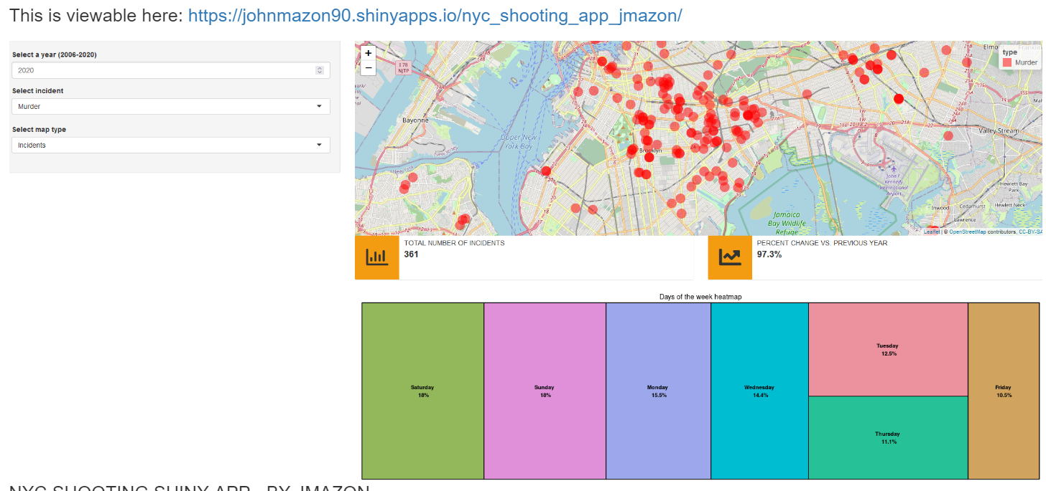
SHINY APP to help visualize geograhic incidents
The initial exploration for this Project began by me creating a shiny app[dashboard] in R to visualize the Open Source NYC Shooting Data. I created selection options for users to be able to view the data by year(2006-2020), select the type of incident[murder or non-murder shootings] and by borough. In addition to these options further information such as Total Number of Incidents, Percent Change vs. Previous Year and a Heatmap are provided.
https://johnmazon90.shinyapps.io/nyc_shooting_app_jmazon/

Slide 5
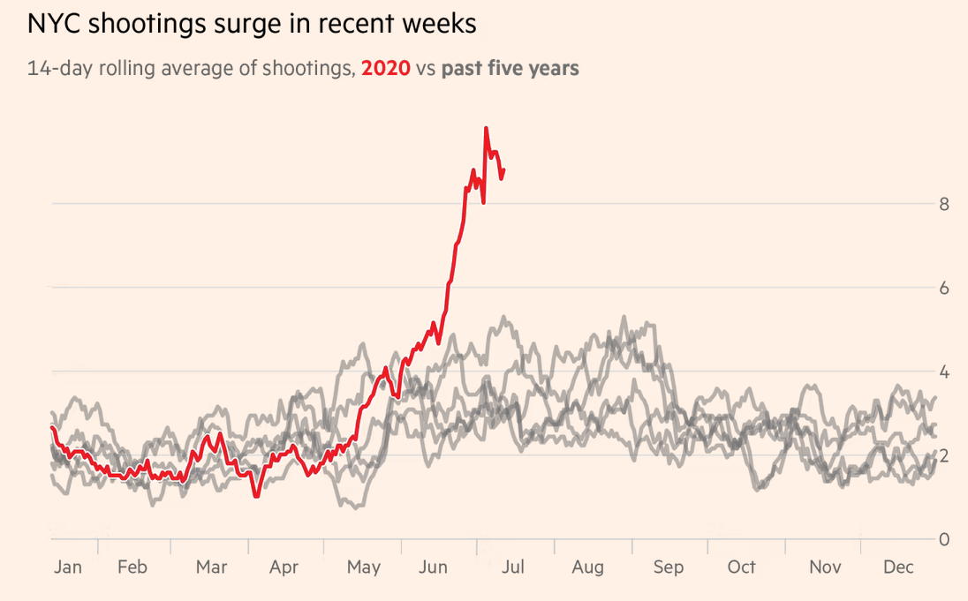
Visualizations of NYC Shooting trend

Slide 6
Uptick in Shooting incident by Quarter
When observing the NYC Shooting time series graph(by quarter from 2006-2021) it is
visually certain that there is a seasonal trend in how NYC shootings occur. You’ll notice from
the seasonal plot that there is heavy volume in the occurrence of shooting indeed in the Quarter 3
of the year. This proves for certain our piece hypothesis that summer time(quarter) is in fact the
highest for shooting occurence in NYC. You will see that this trend spiked even more noticeably
around 2020 to about 400-500 occurrences. Many will correlate this to the days of covid. You'll
notice around this time many newspaper publications stating NYC shootings and homicides
soared in 2020, crime data shows. Shootings and murders skyrocketed in 2020 throughout the
Big Apple. The number of shootings soared 97% from 777 in 2019 to 1,531 in 2020 and
murders jumped by 44% from 319 to 462, according to the NYPD.

Slide 7
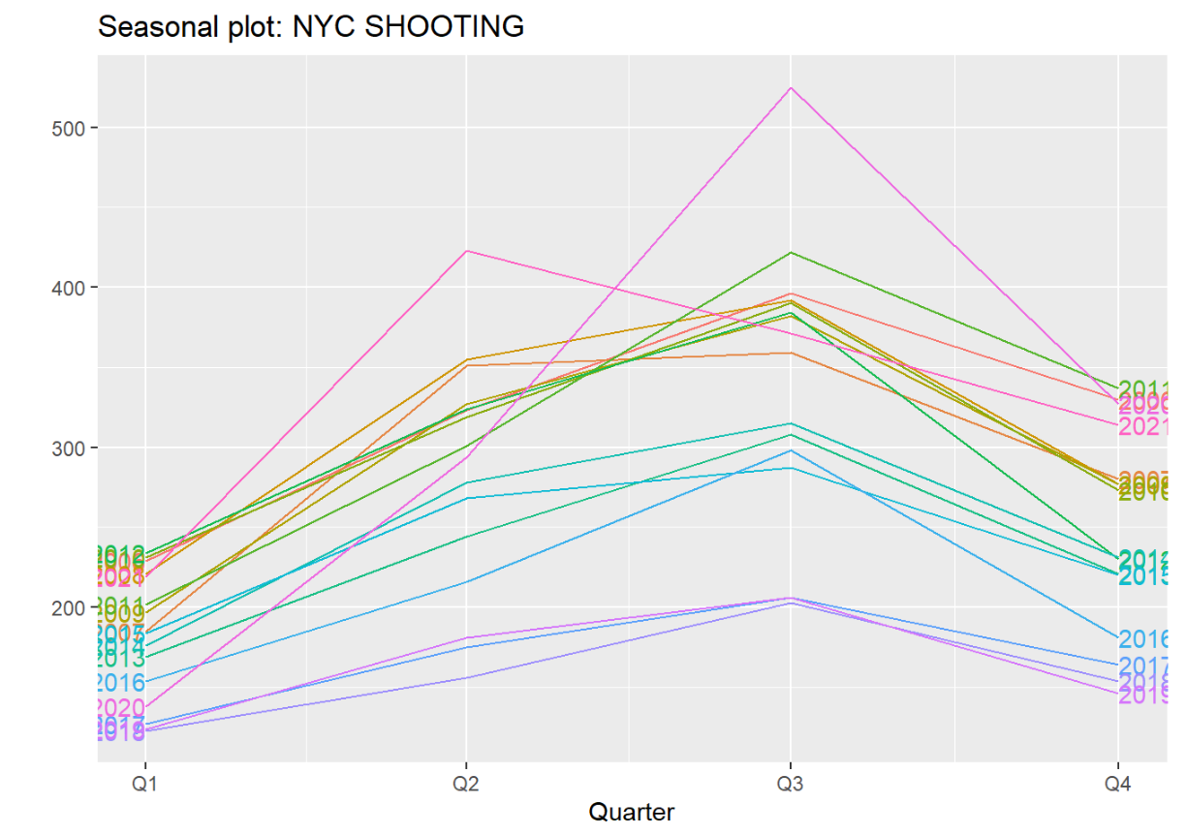

Slide 8
Seasonal and Trend decomposition using Loess (STL)
From observing the output of our STL for the grouped by borough data we can clearly see which is stronger and weaker in this respect. Seasonal-Trend
decomposition using LOESS (STL) is a robust method of time series decomposition often used in economic and environmental analyses. The STL method
uses locally fitted regression models to decompose a time series into trend, seasonal, and remainder components. Coming in at number 1, we see the
trend_strength the strongest for Brooklyn at 0.853639. Secondly, Manhattan with 0.826397. Weakest in this respect would be
Staten Island at 0.4322117. For almost all categories you’ll see Brooklyn has the strongest seasonal_strength as well as the highest in ‘spikiness’ measure.
Curvature is also spotted at 62.4462547. Advantages of the STL decomposition are that the seasonal component can change
over time, the rate of change is controlled by the parameter seasonal width. The parameter robust can be set to true to remove effects of outliers on the
calculation of trend and seasonal component. Also the results of the STL is defined for all points of the time series data.

Slide 9
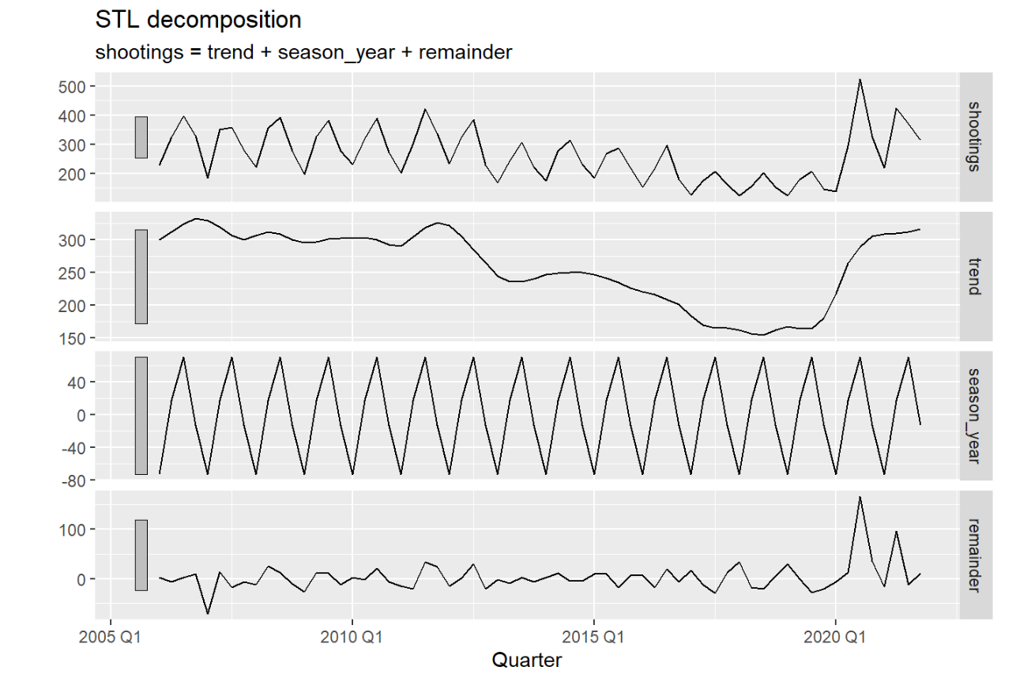

Slide 10
Season Strength - categorical variable comparison(vic_age_group)
You’ll also notice using the time series features I was able to analyze output from boroandrace_shootings so we can witness which Victime age
group showed the strongest seasonal strength. For the three main boroughs of Bronx, Brooklyn, Manhattan there is a strong VIC_AGE_Group of 18-24.
Lowest age group for victim of course being less than 18 years of age or over 65 years of age. They say economic hardships exacerbated by the pandemic
and a lack of government support to those hardest hit are among the primary culprits. New York is experiencing the worst gun violence it has seen in nearly a
decade, all while it continues to fight a pandemic that has killed tens of thousands of New Yorkers and left many more jobless and
hungry.
In 2021 alone, 299 people have been shot, a 54% increase over the same time last year, and the
most the city has seen since 2012. While determining why these crime patterns exist is up to
interpretation–be it holiday travel, work-life stressors, changes in temperature causing behavioral
changes, etc.,

Slide 11
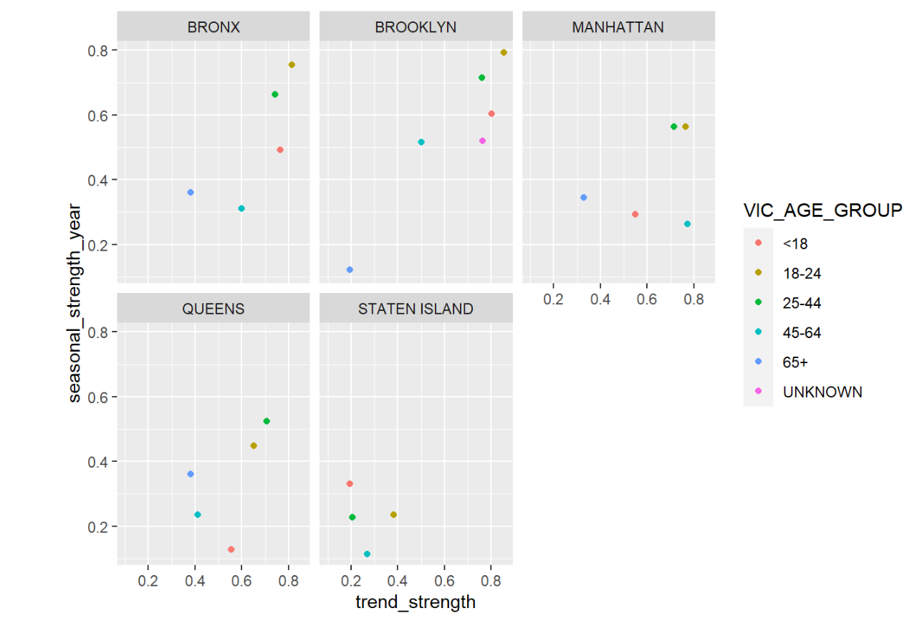

Slide 12
Conclusion
In conclusion, although we have seen unprecedented spikes in NYC shootings, viewing an overall snapshot of the past 50 years, we see
an evident triumph of NYC over crime. In addition, it is well known that during certain quarters(Q3-Summer) time we see an uptick in
incidents. We attribute the steady decrease of shootings in NYC due to today’s NYPD officers which are expanding their focus by studying
crime trends and monitoring community complaints, such as those to 311, that shed deeper insight into the geneses of crime. Proactive
engagement with offenders, relentless investigations and follow-up, and rapid deployment are proven methods to reduce crime and disorder on
the streets, in the subways, or in public housing. As New York confronts a fiscal crisis, its leaders need to remember that the city owes its crime
decline to a broad range of public and private agencies. Maintaining the NYPD’s commitment to its proven crime-fighting methods is crucial,
of course. But so is the broader citywide emphasis on public order.

Slide 13


Let’s use Data Science analytics to help combat NYC CRIME!

